Slide 1
Translation
&
Rotation

Slide 2
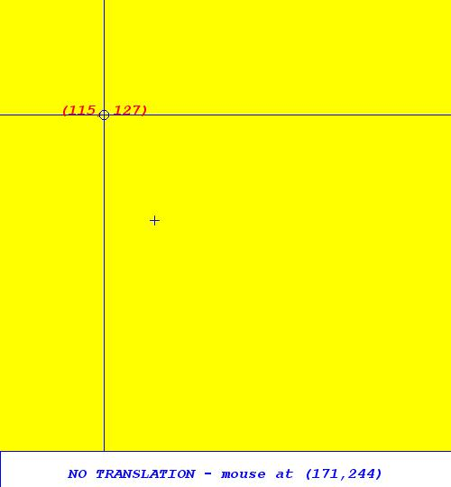
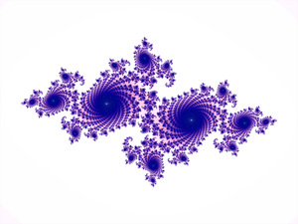
void keyPressed() {
switch(key) {
case 'x':
x+= 1;
break;
case 'y':
y+= 1;
break;
case 'u':
x-= 1;
break;
case 'v':
y-= 1;
break;
}
}
115
127
244
171
In this demo the vertical line can be moved by clicking x (+1) or u (-1).
The horizontal line can be moved by clicking y (+1) or v (-1).
This is the situation up until now for us. If I move the vertical or horizontal line then the red coordinates change but not the + marking the mouse position
TranslateDemo_1

Slide 3
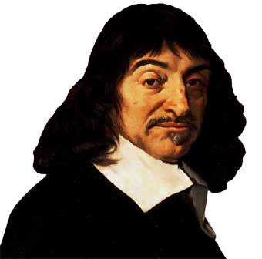
void draw() {
String Status;
background(Yellow);
line(x, 0, x, H);//Draws vertical line
line(0, y, W, y);//Draws horizontal line
textAlign(CENTER);
fill(Red);
text("(" + x +", " + y + ")", x, y);
//text draws (x, Y) of line intersectio
noFill();
stroke(Blue);
ellipse(x, y, 10, 10);
line(mouseX - 5, mouseY, mouseX + 5, mouseY);
//draws vertical component of cross
line(mouseX, mouseY - 5, mouseX, mouseY + 5);
//draws horizontal component of cross
fill(White);
rect(0, H - PanelH, W, PanelH);
Status = "NO TRANSLATION";
fill(Blue);
Status = Status + " - mouse at " + "(" + mouseX + ",";
Status = Status + mouseY + ")";
text(Status, W/2, H - 10);
}
René Descartes (1596-1650)
So, nothing new! Just a reminder about (x, y) coordinates!
TranslateDemo_1

Slide 4
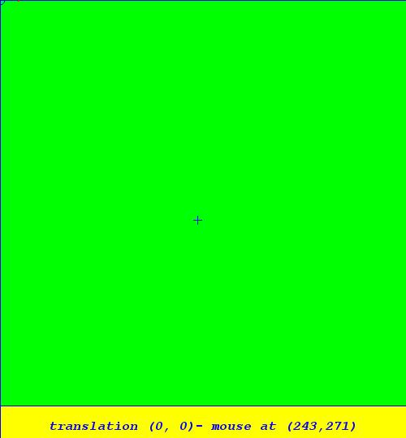
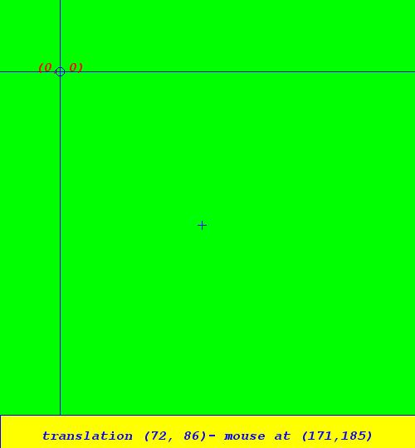
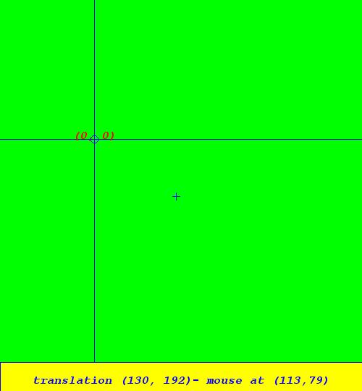
TranslateDemo_2

Slide 5
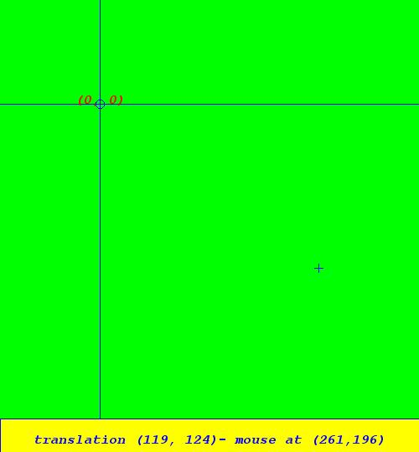
Now I move the origin – i.e. the (0, 0) point. The position of the + marking the mouse position, with respect to the new origin position changes.
It is at (261, 196) with respect to the new origin.
But with respect to the old origin it is at
(380, 320).
124 + 196 = 320
196
We say “the y-axis has been translated by 119 units to the right”.
261
119 + 261 = 380
TranslateDemo_2

Slide 6
To achieve this effect we do some simple arithmetic on the coordinates.
If the mouse’s x coordinate is mouseX, and I have moved the vertical line to x-coordinate x, then it is another mouseX – x distance to the cross marking the mouse position.
void draw() {
String Status;
background(Green);
line(x, 0, x, H);
line(0, y, W, y);
textAlign(CENTER);
fill(Red);
text("(" + 0 +", " + 0 + ")", x, y);
noFill();
stroke(Blue);
ellipse(x, y, 10, 10);
line(mouseX - 5, mouseY, mouseX + 5, mouseY);
line(mouseX, mouseY - 5, mouseX, mouseY + 5);
fill(Yellow);
rect(0, H - PanelH, W, PanelH);
fill(Blue);
Status = "translation (" + x + ", " + y + ")";
Status = Status + "- mouse at " + "(" + (mouseX - x) + ",";
Status = Status + (mouseY - y) + ")";
text(Status, W/2, H - 10);
}
So far I have been coding the translation for demo purposes.
Next we shall look at Processing’s built in method for this.
Similarly for mouseY and y
TranslateDemo_2

Slide 7
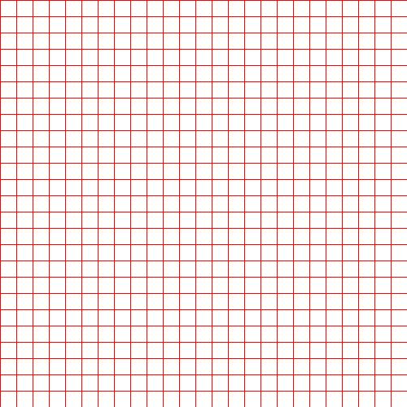
class Grid {
int Side;
color LineCol;
Grid(int Side) {
this.Side = Side;
}
void Draw() {
int i;
stroke(LineCol);
for(i = 0; i <= width; i+=Side) {
line(i, 0, i, height - 2 * PanelH);
line(0, i, width, i);
}
}
}
GridDemo_2
Grid
Utils
int W = 500,
H = W;
int GSide = 20;
Grid RG = new Grid(GSide);
void setup() {
size(W, H);
RG.LineCol = Red;
background(White);
RG.Draw();
save("Grid.jpg");
}
GridDemo

Slide 8
translate()
Edited excerpt from Processing reference
Description
Specifies an amount to displace objects within the display window. The x parameter specifies left/right translation, the y parameter specifies up/down translation.
Transformations apply to everything that happens after and subsequent calls to the function accumulates the effect.
For example, calling translate(50, 0) and then translate(20, 0) is the same as translate(70, 0).
If translate() is called within draw(), 1 or more times, the total transformation is reset when draw() terminates.

Slide 9
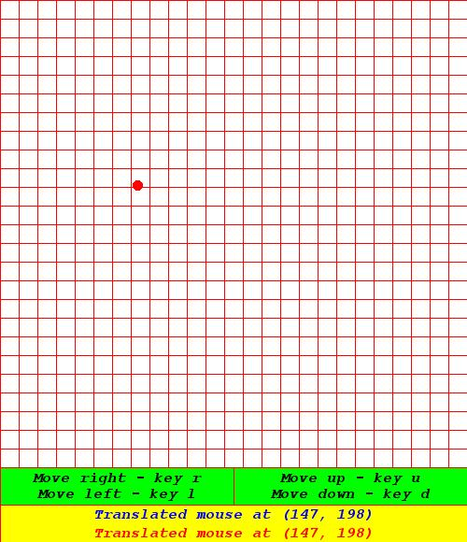
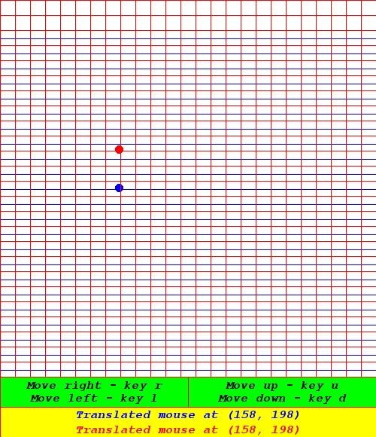
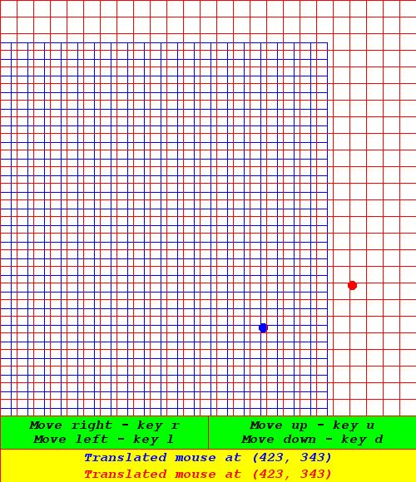
TranslateDemoGrid1
TranslateDemoGrid1
Grid
Utils

Slide 10
TranslateDemoGrid1
void draw() {
background(White);
translate(X, Y);
TmX = mouseX;
TmY = mouseY;
BG.Draw();
fill(Blue);
ellipse(mouseX, mouseY, 10, 10);
translate(-X, -Y);
RG.Draw();
fill(Red);
ellipse(mouseX, mouseY, 10, 10);
rectMode(CENTER);
fill(Yellow);
rect(width/2, height - PanelH/2, width, PanelH);
fill(Green);
rect(W/4, H - 3 * PanelH/2, width/2, PanelH);
rect(3 * W/4, H - 3 * PanelH/2, width/2, PanelH);
textAlign(CENTER, CENTER);
fill(Black);
text("Move right - key r\nMove left - key l", width/4 , H - 3 * PanelH/2);
text("Move up - key u\nMove down - key d", 3 * width/4, H - 3 * PanelH/2);
fill(Red);
text("Untranslated mouse at " + "(" + mouseX + ", " + mouseY + ")", W/2, H - PanelH/4);
fill(Blue);
text("Translated mouse at " + "(" + TmX + ", " + TmY + ")", W/2, H - 3 * PanelH/4);
}

Slide 11
void draw() {
background(White);
translate(X, Y);
TmX = mouseX;
TmY = mouseY;
BG.Draw();
fill(Blue);
ellipse(mouseX, mouseY, 10, 10);
translate(-X, -Y);
RG.Draw();
fill(Red);
ellipse(mouseX, mouseY, 10, 10);
……………
Make (X, Y) the new origin by translation
Save the mouseX and mouseY values under the new coordinate system.
Draw the blue grid and the blue circle in the new coordinate system
Translate (–X, -Y) from (X, Y) to
(X + (-X), Y + (-Y)) = (0, 0)
void keyPressed() {
switch(key) {
case 'r':
X += 1;
break;
case 'l':
X -= 1;
break;
case 'u':
Y -= 1;
break;
case 'd':
Y += 1;
break;
}
}
Draw the red grid and the red circle in the original coordinate system
Use these keys to move the new coordinate system.
TranslateDemoGrid1

Slide 12
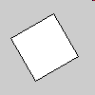
rotate()
Name
rotate()
Examples
translate(width/2, height/2);
rotate(PI/3.0);
rect(-26, -26, 52, 52);
Description
Rotates a shape the amount specified by the angle parameter. Angles should be specified in radians (values from 0 to TWO_PI) or converted to radians with the radians() function.
Objects are always rotated around their relative position to the origin and positive numbers rotate objects in a clockwise direction. Transformations apply to everything that happens after and subsequent calls to the function accumulates the effect. For example, calling rotate(HALF_PI) and then rotate(HALF_PI) is the same as rotate(PI). All tranformations are reset when draw() begins again.
Technically, rotate() multiplies the current transformation matrix by a rotation matrix. This function can be further controlled by the pushMatrix() and popMatrix().
Edited excerpt from Processing reference

Slide 13
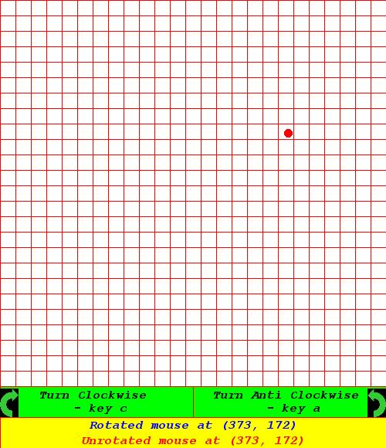
int PanelH = 40;
int W = 500,
H = W + 2 * PanelH;
PFont Font;
RectButton Turn_CW,
Turn_ACW;
PImage CWArrowIm,
ACWArrowIm;
int GSide = 20;
Grid RG = new Grid(GSide);
Grid BG = new Grid(GSide);
float Theta = 0;
GSide
RotateDemo_1
CWArrowIm
Grid
Utils
PanelH
TurnCW
RotateDemo_1

Slide 14
void setup() {
size(W, H);
RG.LineCol = Red;
BG.LineCol = Blue;
Font = loadFont("CourierNewPS-BoldItalicMT-16.vlw");
textFont(Font);
Turn_CW = new RectButton(W/4, H - PanelH * 3/2, W/4, PanelH/2);
Turn_CW.Font = Font;
Turn_CW.Legend = "Turn Clockwise \n - key c";
Turn_CW.Col = Green;
Turn_ACW = new RectButton(3 * W/4, H - PanelH * 3/2, W/4, PanelH/2);
Turn_ACW.Font = Font;
Turn_ACW.Legend = "Turn Anti Clockwise \n - key a";
Turn_ACW.Col = Green;
CWArrowIm = loadImage("CWArrow.jpg");
ACWArrowIm = loadImage("ACWArrow.jpg");
}
RotateDemo_1

Slide 15
int RmX,
RmY;
void draw() {
background(White);
rotate(Theta);
RmX = mouseX;
RmY = mouseY;
BG.Draw();
textAlign(CENTER);
fill(Blue);
ellipse(mouseX, mouseY, 10, 10);
rotate(-Theta);
RG.Draw();
Turn_CW.Draw();
Turn_ACW.Draw();
fill(Red);
ellipse(mouseX, mouseY, 10, 10);
image(CWArrowIm, 0, H - PanelH - CWArrowIm.height/5,
CWArrowIm.width/5, CWArrowIm.height/5);
image(ACWArrowIm, W - ACWArrowIm.width/5, H - PanelH - ACWArrowIm.height/5,
ACWArrowIm.width/5, CWArrowIm.height/5);
fill(Yellow);
rect(width/2, height - PanelH/2, width, PanelH);
fill(Red);
text("Unrotated mouse at " + "(" + mouseX + ", " + mouseY + ")", W/2, H - PanelH/4);
fill(Blue);
text("Rotated mouse at " + "(" + RmX + ", " + RmY + ")", W/2, H - 3 * PanelH/4);
}
void keyPressed() {
switch(key) {
case 'c':
Theta += 0.01;
break;
case 'a':
Theta -= 0.01;
break;
}
}
rotate(Theta) rotates the frame of reference Theta radians clockwise about the current origin.
BG and the ellipse get drawn in the new frame of reference.
rotate(-Theta) rotates the frame of reference -Theta radians clockwise about the current origin – i.e. Theta radians anticlockwise about the current origin. This resets the frame of reference to that the programme had on starting.
RotateDemo_1

Slide 16
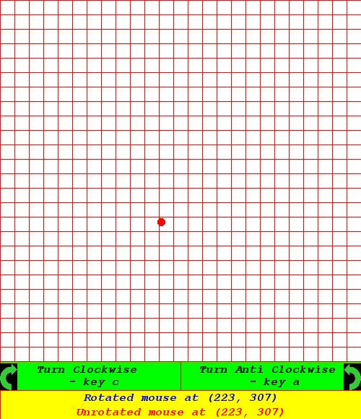
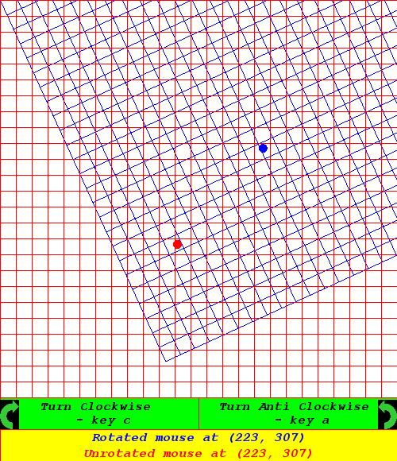
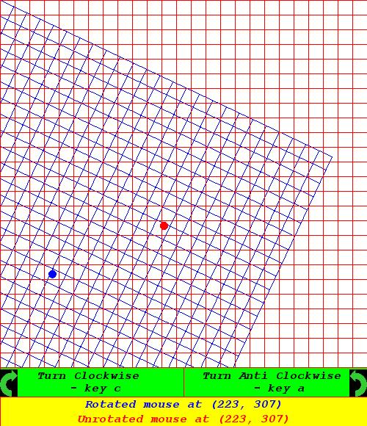
RotateDemo_1
The red dot is at the same position in the red grid (223, 307) as the blue dot is in the blue grid (223, 307) as we rotate the blue grid (or frame of reference)

Slide 17
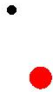
Suppose we require a simulation of a modest solar system with a black dwarf sun and a big red planet.
The ‘obvious way to do this’ and it’s not difficult but…
R
R * sine(Theta)
Theta
R * cosine(Theta)
SolarSystem0

Slide 18
int W = 500,
H = W;
float Unit = PI/1000;
void setup() {
size(W, H);
stroke(Red);
}
int i = 0;
void draw() {
background(White);
fill(Black);
stroke(Black);
ellipse(300, 200, 10, 10);
translate(300, 200);
rotate(i * Unit);
fill(Red);
stroke(Red);
ellipse(60, 60, 25, 25);
i++;
}
…Processing gives you a better way!
Draw the black sun
Move the origin to the centre of the black sun
Rotate by i * Unit about the origin
Draw a red planet at position (60, 60);
Increment I by 1 so that the rotation is a little more next time round
SolarSystem0

Slide 19
int W = 500,
H = W;
int GSide = 20;
Grid OG = new Grid(GSide);
Grid BG = new Grid(GSide);
float Unit = PI/1000;
void setup() {
size(W, H);
stroke(Red);
OG.LineCol = Orange;
BG.LineCol = Black;
}
int i = 0;
void draw() {
background(White);
OG.Draw();
fill(Black);
stroke(Black);
ellipse(300, 200, 10, 10);
translate(300, 200);
rotate(i * Unit);
BG.Draw();
fill(Red);
stroke(Red);
ellipse(60, 60, 25, 25);
i++;
}
SolarSystemGrid0

Slide 20
int W = 500,
H = W;
int GSide = 20;
Grid OG = new Grid(GSide);
Grid BG = new Grid(GSide);
float Unit = PI/1000;
void setup() {
size(W, H);
stroke(Red);
OG.LineCol = Orange;
BG.LineCol = Black;
}
int i = 0;
void draw() {
background(White);
fill(Black);
stroke(Black);
ellipse(300, 200, 10, 10);
translate(300, 200);
rotate(i * Unit);
fill(Red);
stroke(Red);
ellipse(60, 60, 25, 25);
translate(60, 60);
rotate(5 * i * Unit);
fill(Blue);
stroke(Blue);
ellipse(30, 30, 15, 15);
i++;
}
SolarSystem1

Slide 21
int W = 500, H = W;
int GSide = 20;
Grid OG = new Grid(GSide);
Grid BG = new Grid(GSide);
float Unit = PI/1000;
void setup() {
size(W, H);
stroke(Red);
OG.LineCol = Orange;
BG.LineCol = Black;
}
int i = 0;
void draw() {
background(White);
OG.Draw();
fill(Black);
stroke(Black);
ellipse(300, 200, 10, 10);
translate(300, 200);
rotate(i * Unit);
BG.Draw();
fill(Red);
stroke(Red);
ellipse(60, 60, 25, 25);
translate(60, 60);
rotate(5 * i * Unit);
BG.Draw();
fill(Blue);
stroke(Blue);
ellipse(30, 30, 15, 15);
i++;
}
SolarSystemGrid1

Slide 22
int W = 500,
H = W;
int GSide = 20;
Grid OG = new Grid(GSide);
Grid BG = new Grid(GSide);
float Unit = PI/1000;
void setup() {
size(W, H);
stroke(Red);
OG.LineCol = Orange;
BG.LineCol = Black;
}
int i = 0;
void draw() {
background(White);
fill(Black);
stroke(Black);
ellipse(300, 200, 10, 10);
translate(300, 200);
rotate(i * Unit);
fill(Red);
stroke(Red);
ellipse(60, 60, 25, 25);
translate(60, 60);
rotate(5 * i * Unit);
fill(Blue);
stroke(Blue);
ellipse(30, 30, 15, 15);
translate(30, 30);
rotate(10 * i * Unit);
stroke(Green);
fill(Green);
ellipse(15, 15, 8, 8);
i++;
}
SolarSystem2

Slide 23
int W = 500,
H = W;
int GSide = 20;
Grid OG = new Grid(GSide);
Grid BG = new Grid(GSide);
float Unit = PI/1000;
void setup() {
size(W, H);
stroke(Red);
OG.LineCol = Orange;
BG.LineCol = Black;
}
int i = 0;
void draw() {
background(White);
OG.Draw();
fill(Black);
stroke(Black);
ellipse(300, 200, 10, 10);
translate(300, 200);
rotate(i * Unit);
BG.Draw();
fill(Red);
stroke(Red);
ellipse(60, 60, 25, 25);
translate(60, 60);
rotate(5 * i * Unit);
BG.Draw();
fill(Blue);
stroke(Blue);
ellipse(30, 30, 15, 15);
translate(30, 30);
rotate(10 * i * Unit);
BG.Draw();
stroke(Green);
fill(Green);
ellipse(15, 15, 8, 8);
i++;
}
SolarSystemGrid2

